Slide 1
  SpotWeb: Detecting Framework Hotspots and Coldspots via Mining Open Source Code on the Web
Suresh Thummalapenta and Tao Xie
North Carolina State University
Raleigh, USA
Automated Software Engineering 2008
Notes:
Generate inputs in such a way that the program consumes more resources such as 100% CPU…

Slide 2

Motivation
Programmers commonly reuse APIs of existing frameworks or libraries
  Advantages: Low cost and high efficiency of development
  Challenges: Complexity and lack of documentation
  Consequences:
    Programmers unfamiliar to the framework spend more efforts in reusing APIs
Frame
works

Slide 3

Motivation
Is every class or method has the same importance?
→ No
A few classes and methods are often used compared to other classes and methods
  → Hotspots
A few classes and methods are rarely used
  Coldspots
Our objective is to detect hotspots and coldspots in a given framework to assist users unfamiliar to the framework
JUNG library has 461 public non-internal classes and interfaces and 3241 methods

Slide 4
Outline
Advantages of hotspots and coldspots
Overview of the approach
Detection of hotspots
Detection of coldspots
Evaluation
Conclusion and Future work

Slide 5
Hotspots and Coldspots
Advantages of hotspots
  New users can inspect hotspots to understand commonly reused classes and methods
  Users may have more confidence or tendencies in reusing hotspots as bugs in these hotspots may be fewer
  Developers or maintainers can choose to invest their improvement efforts on these hotspots
Advantages of coldspots
  Coldspots can serve as caveats as there can be difficulties in identifying related code examples

Slide 6
Overview of SpotWeb
Requires domain knowledge of how the framework is reused by applications
Various open source projects on the web can help acquire such domain knowledge for existing frameworks
Open Source Projects on web
Classes
Interfaces
Input
Framework
Related Code
Examples
Hotspots
Coldspots
Usage Metrics

Slide 7
Relevant Code Examples
Interact with a code search engine to collect relevant code examples
Construct a query for each class of the input framework
  Example: Constructed query for the TestSuite class of the JUnit framework is “lang:java junit.framework.TestSuite”
Our approach uses Google code search as underlying code search engine
  Example: Google code search gives 76,400 code examples for the preceding query

Slide 8
Usage Metrics
Usage Metrics characterize how entities such as classes or methods are used
  Classes:
    Instances and Extensions
  Interfaces:
    Implementations
  Exception classes:
  Methods (static and non-static): number of times the methods are invoked, overridden or implemented
  Constants: number of times the constants are referred

Slide 9
An Example Framework
class C1 {
C1 () { … }
m1_1 (C3 arg1) { … }
m1_2 () { … }
final static constC1;
}
class C2 {
C2 (C1 arg1) { … }
m2_1 (C3 arg1) { … }
m2_2 () { … }
final static constC2;
}
abstract class C3 {
abstract m3_1 ();
abstract m3_2 ();
abstract m3_3 ();
}
class ExceptClass
extends Exception
{
}

Slide 10
Computed Usage Metrics
class C1 {
/*IN = 10,EX=0,IM = 0*/
C1 () { … } /*IN = 10,OV=0,IM = 0*/
m1_1 (C3 arg1) { … } /*IN = 8,OV = 0,IM = 0*/
m1_2 () { … } /* IN = 3, OV=0,IM=0*/
final static constC1; /* UM = 6 */
}
class C2 {
/*IN = 6,EX=2,IM = 0*/
C2 (C1 arg1) { … } /*IN = 6,OV=0,IM = 0*/
m2_1 (C3 arg1) { … } /*IN = 6,OV = 2,IM = 0*/
m2_2 () { … } /*IN = 1,OV = 2,IM = 0*/
final static constC2; /* UM = 1 */
}
Class C2 instantiated (IN) for 6 times and extended (EX) for 2 times
Method m2_2 is invoked once and overridden for 2 times
abstract class C3 {
/*IN = 0,EX=12,IM = 0*/
abstract m3_1 (); /*IN = 0,OV=12,IM = 0*/
abstract m3_2 (); /*IN = 0,OV=12,IM = 0*/
abstract m3_3 (); /*IN = 0,OV=12,IM = 0*/
}
class ExceptClass
extends Exception
{
/* UM = 9 */
}

Slide 11
Detection of Hotspots
Entity | UM
C1 () | 10
m1_1 () | 8
m1_2 () | 3
constC1 | 6
C2 () | 6
m2_1 () | 8
m2_2 () | 3
constC2 | 1
m3_1 () | 12
m3_2 () | 12
m3_3 () | 12
ExceptClass() | 9
Entity | UM | Rank
m3_1 () | 12 | 1
m3_2 () | 12 | 2
m3_3 () | 12 | 3
C1 () | 10 | 4
ExceptClass() | 9 | 5
m1_1 () | 8 | 6
m2_1 () | 8 | 7
constC1 | 6 | 8
C2 () | 6 | 9
m1_2 () | 3 | 10
m2_2 () | 3 | 11
constC2 | 1 | 12
sort
Top HT entities are selected as hotspot entities

Slide 12
Detection of Hotspots
Rank 1
Hotspot entities are grouped into their declaring classes
Each hotspot class is classified as a hook or a template
Hooks represent flexible parts of the framework where users can define a new behavior
  Example: Class c3
Templates represent immutable parts of the framework
Example: Class c1
abstract class C3 {
/*IN = 0,EX=12,IM = 0*/
abstract m3_1 (); /*IN = 0,OV=12,IM = 0*/
abstract m3_2 (); /*IN = 0,OV=12,IM = 0*/
abstract m3_3 (); /*IN = 0,OV=12,IM = 0*/
}
Rank 4
class C1 {
/*IN = 10,EX=0,IM = 0*/
C1 () { … } /*IN = 10,OV=0,IM = 0*/
m1_1 (C3 arg1) { … } /*IN = 8,OV = 0,IM = 0*/
}
Rank 5
class ExceptClass
extends Exception
{
/* UM = 9 */
}
Notes:
Classification of hook or template gives an immediate hint to the user of how to reuse that class.

Slide 13
Detection of Hotspots
Rank 1
Classify each hotspot class, say C_{i,} into a hook or template based on number of instantiations and extensions
  Example: C3 is a hook class and C1 is a template class
An interface is always classified as a hook
An exception class is always classified as a template
abstract class C3 {
/*IN = 0,EX=12,IM = 0*/
abstract m3_1 (); /*IN = 0,OV=12,IM = 0*/
abstract m3_2 (); /*IN = 0,OV=12,IM = 0*/
abstract m3_3 (); /*IN = 0,OV=12,IM = 0*/
}
Rank 4
class C1 {
/*IN = 10,EX=0,IM = 0*/
C1 () { … } /*IN = 10,OV=0,IM = 0*/
m1_1 (C3 arg1) { … } /*IN = 8,OV = 0,IM = 0*/
}
Rank 5
class ExceptClass
extends Exception
{
/* UM = 9 */
}

Slide 14
Detection of Hotspots
Rank 1, Type: Hook
Identify dependencies that can further help users of how to reuse hotspot classes
  Dependencies are captured based on method arguments
Two types of dependencies are captured: TEMPLATE_TEMPLATE and TEMPLATE_HOOK
  C1 has a TEMPLATE_HOOK dependency on C3 as m1_1 of C1 has an argument of type C3 ( C1 → C3)
abstract class C3 {
/*IN = 0,EX=12,IM = 0*/
abstract m3_1 (); /*IN = 0,OV=12,IM = 0*/
abstract m3_2 (); /*IN = 0,OV=12,IM = 0*/
abstract m3_3 (); /*IN = 0,OV=12,IM = 0*/
}
Rank 2, Type: Template
class C1 {
/*IN = 10,EX=0,IM = 0*/
C1 () { … } /*IN = 10,OV=0,IM = 0*/
m1_1 (C3 arg1) { … } /*IN = 8,OV = 0,IM = 0*/
}
Rank 3, Type: Template
class ExceptClass
extends Exception
{
/* UM = 9 */
}
Notes:
Having dependencies help users to figure out the order of how to use those classes or methods.

Slide 15
Hotspots of JUnit Framework
public class SRDAOTestCase extends TestCase {
private SRDAO dao = null;...
public SRDAOTestCase() {
super(); ... }
protected void setUp() throws Exception {
dao = (SRDAO)context.getBean("SRDAO");
... }
public void tearDown() throws Exception {
dao = null; }
public void testF() { ... }
public void testB() { ... }
}
JUnit is a de facto standard unit testing framework for Java
Our approach detected 14 classes as hotspot classes in the JUnit framework
junit.framework.
TestSuite
junit.framework.
TestCase
<init>(Class)
addTest(Test)
<init>()
<init>(String)
addTestSuite(Class)
setName(String)
getName()
TEMPLATE_HOOK
getName()
setName(String)
setUp()
tearDown()
public class MyTestSuite {
...
public static Test suite() {
TestSuite suite = new TestSuite("axis");
suite.addTest(new SRDAOTestCase());
return suite;
}
...
}
TestCase class inherits from the Test class
white: template, gray: hook
Notes:
Having dependencies help users to figure out the order of how to use those classes or methods.

Slide 16
Detection of Coldspots
Classes and methods that are rarely used are identified as coldspots
Algorithm for detecting coldspots:
  Input: A method M_{i} of a class C_{j}
  Output: Is the method a coldspot or not?
  1: Return false if the method is reused atleast once;
  2: if C_{j} is an interface
  Return true if all implemented methods of M_{i} are coldspots;
  Otherwise return false;
  3: if M_{i} is abstract
  Return true if all overridden methods of M_{i} are coldspots;
  Otherwise return false;
  4: Return true if all callers of M_{i} are coldspots
  Otherwise return false;
Notes:
Give the example of abstract method to explain why we need this recursive algorithm

Slide 17
Evaluation
What is the percentage of hotspots and coldspots in each subject framework?
  Helps characterize the reuse efforts of the framework
Is the subset of classes and methods detected as hotspots indeed useful in helping effective framework reuse?
  Helps show that our approach can reduce the efforts of users
What is the effectiveness of our hotspot detection in terms of precision and recall?
  Compare with the available documentation
  Compare with a previous related approach
Notes:
Give the example of abstract method to explain why we need this recursive algorithm

Slide 18
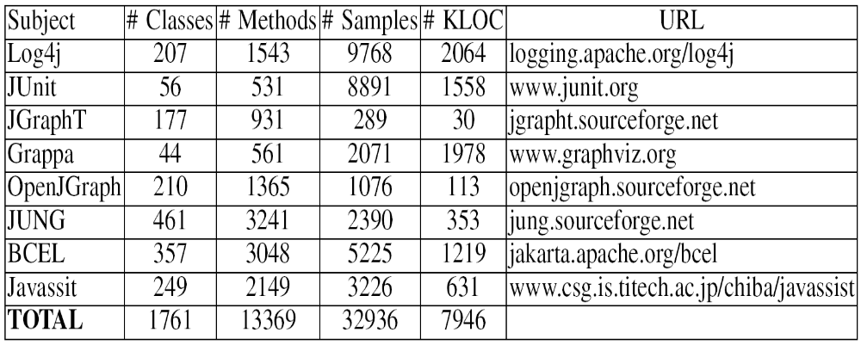
Subjects
Used eight popular frameworks for detecting hotspots and coldspots
Analyzed seven million lines of code gathered from open source projects on the web
Notes:
Give the example of abstract method to explain why we need this recursive algorithm

Slide 19
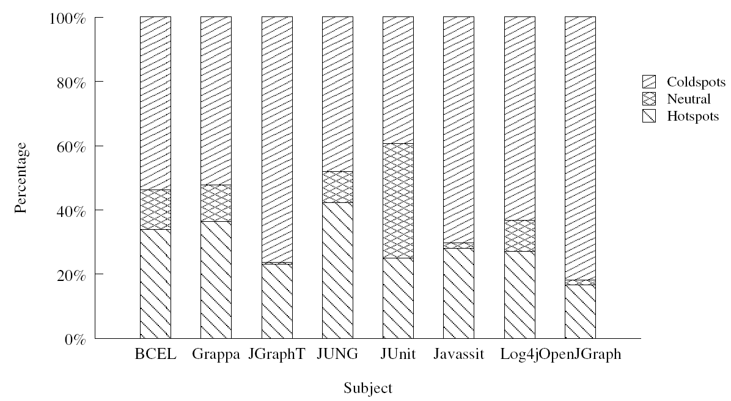
RQ1: Statistics of Hotspots and Coldspots
What is the percentage of hotspots and coldspots in each subject framework?
On average
percentage of hotspots range from 16% to 42%
percentage of coldspots range from 39% to 82%
results indicate that a class is either reused heavily or never reused
Notes:
Talk about the reuse efforts as a part of this result. Some may question about Neutral category… prepare a diplomatic answer…

Slide 20
RQ1: Statistics of Hotspots and Coldspots
Example hotspot classes detected with four graph libraries JGraphT, JUNG, OpenJGraph, and Grappa
Each graph library provides several different types of graphs such as the JUNG library provides graph types: DirectedGraph, ArchetypeGraph, and HyperGraph.
Popular graph types detected by our approach:
  JGraphT: DefaultListenableGraph
  JUNG: DirectedSparseGraph
  OpenJGraph: DirectedGraphImpl
  Grappa: Graph
Notes:
Talk about the reuse efforts as a part of this result. Some may question about Neutral category… prepare a diplomatic answer…

Slide 21
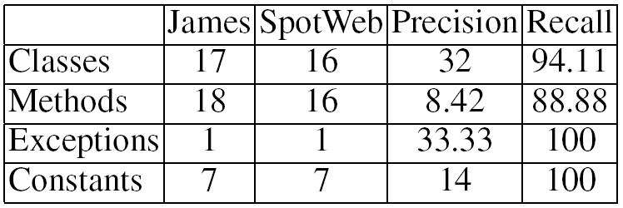
RQ2: Utilities of Hotspots
Is the subset of classes and methods detected as hotspots indeed useful in helping effective framework reuse?
  Subject: DNSJava (154 classes and 1224 methods)
  Classified all DNSJava reusing applications (except James application) as training applications and James application as a test application
  Objective: To validate detected hotspots using James as a test application
  Result: SpotWeb detected 47 classes, 190 methods, 3 exceptions, and 50 constants as hotspots
Notes:
Talk about the reuse efforts as a part of this result. Some may question about Neutral category… prepare a diplomatic answer… Highlight the recall part. Precision is still fine and we can discuss in the next slide

Slide 22
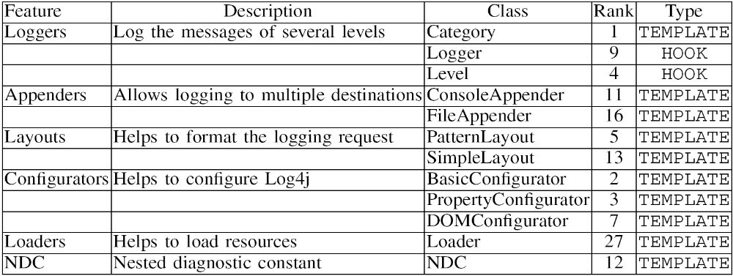
RQ3a: Effectiveness of Hotspot Detection
What is effectiveness of hotspot detection in terms of precision and recall?
  Subject: Log4j (207 classes and 1543 methods)
  Compared detected hotspots with online documentation that describes 12 commonly used classes as hotspot classes
  Result: SpotWeb detected 56 classes as hotspot classes with a threshold value (HT) of 15%.
    Recall: 100% and Precision: 21.42%
Notes:
Main point is except “Loader” Class, all other top 11 classes are ranked among top 16 classes.

Slide 23
RQ3b: Effectiveness of Hotspot Detection
Comparison with a previous related approach [Viljamaa FSE03] for the JUnit framework
  Viljamaa’s approach detected 7 classes as hotspots
  SpotWeb detected 5 classes among these 7 classes.
    Missing two classes are ExceptionTestCase and ActiveTestSuite, which are not described in the documentation also
  SpotWeb also detected 4 new classes and several new methods that are not detected by Viljamaa’s approach and are specified in the available documentation of JUnit as commonly used classes and methods
    New classes are Assert, TestResult, TestFailure and new methods such as tearDown of TestCase class
  The results show that SpotWeb performs better than Viljamaa’s approach and unlike their approach, SpotWeb does not require the users to have initial knowledge of the framework
Notes:
Main point is except “Loader” Class, all other top 11 classes are ranked among top 16 classes.

Slide 24
Conclusion and Future Work
An approach that assists programmers, who are unfamiliar to a framework, by detecting hotspots and coldspots
SpotWeb addresses major problems faced by previous approaches by not requiring any manual efforts and by collecting related code examples through a code search engine
We evaluated SpotWeb with eight popular frameworks and also compared with a previous related approach
Future work:
  Explore other applications of hotspots such as prioritization of bug reports based on hotspots

Slide 25
Questions?

